Slide 1


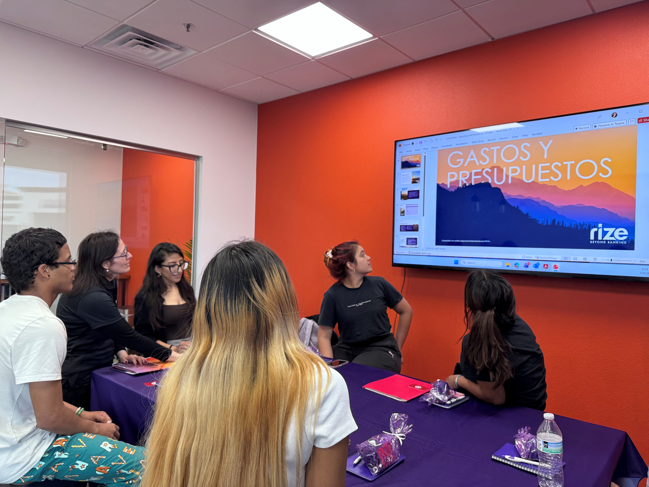
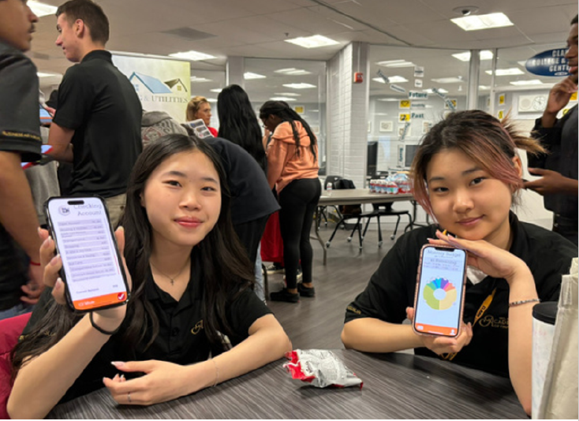
CENTER FOR FINANCIAL EMPOWERMENT
The Center For Financial Empowerment serves the "community as a whole" through education of 4 pillars around Financial Empowerment, Entrepreneurship, Clean Energy and Homeownership. Through Financial Empowerment our mission is to break the cycle of generational poverty and create financial stability by providing financial education.
Our Financial literacy workshops cover:
  Budgeting
  Saving
  Investing
  Using credit
Mad City Money simulations that teach students how to manage a household budget and make financial decisions.
Scholarship programs for low-income students

Slide 2




CENTER FOR FINACIAL EMPOWERMENT and rize credit union
Meeting Community Needs Through Financial Empowerment
Community Need :
As inflation continues to strain families, practical and accessible financial education is more important than ever.
Growing demand: Partners are seeing more interest in classes that build everyday money-management skills.
Trusted support: Rize Credit Union connects community members with reliable banking services and financial guidance.
Safer options: This work helps protect individuals from predatory lending and abusive financial services.

